Slide 1
Final Project Analytics Programming

Slide 2
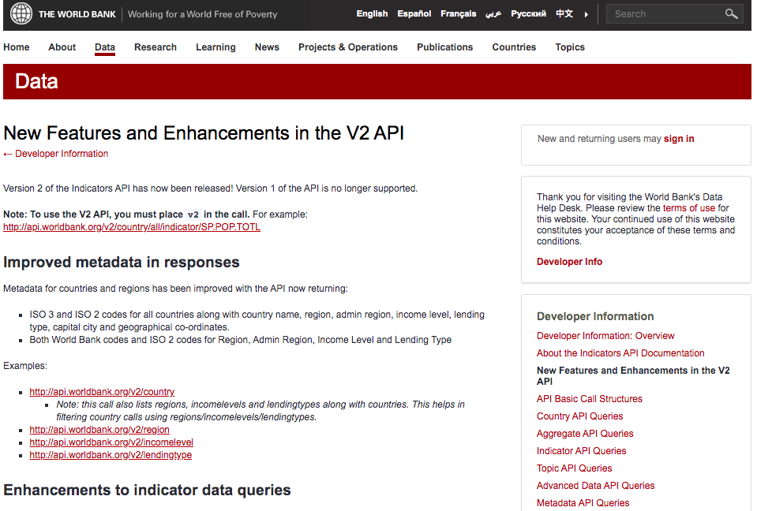
I am interested in understanding the income distribution of different countries in the world , and the relationship with economics freedom. The data API provided by the world bank from the link ：
https://datahelpdesk.worldbank.org/knowledgebase/topics/125589-developer-information.
There is other data source I downloaded from https://www.fraserinstitute.org/studies/economic-freedom in CVS format.

Slide 3
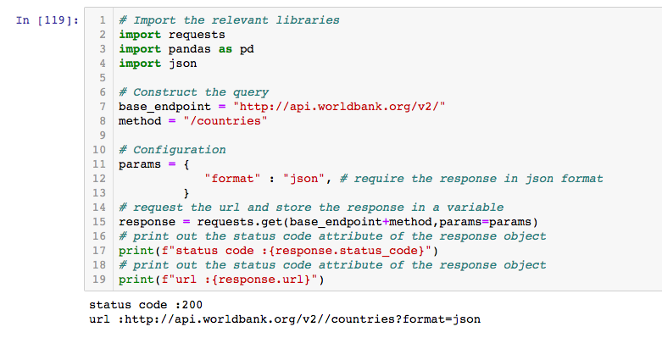

Slide 4
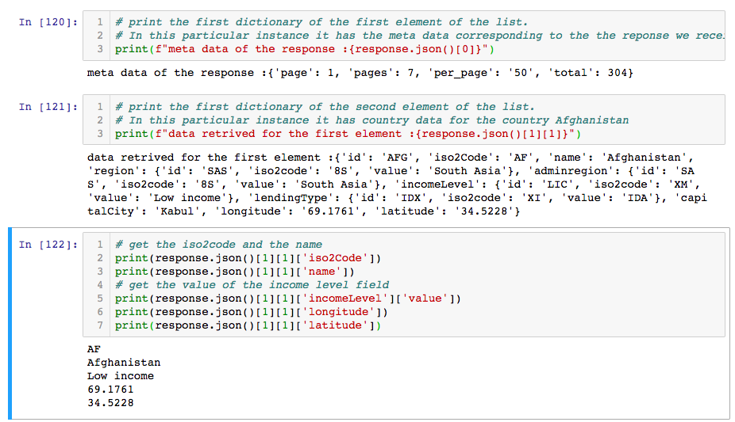

Slide 5
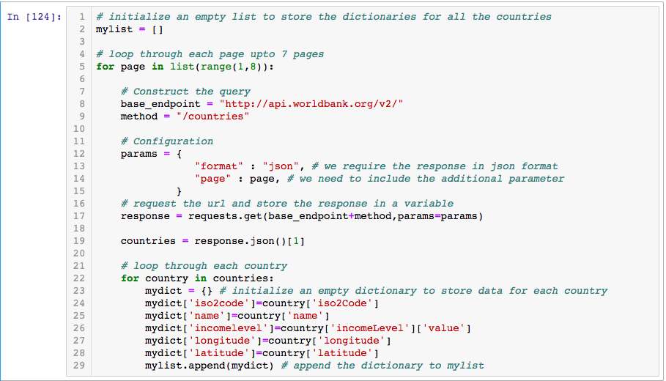

Slide 6
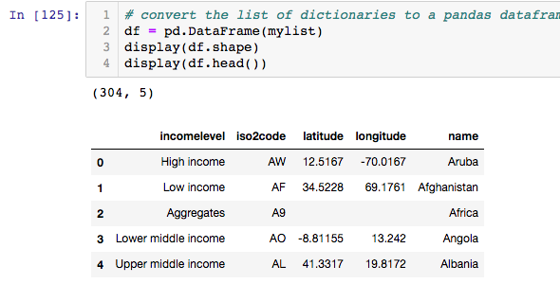

Slide 7
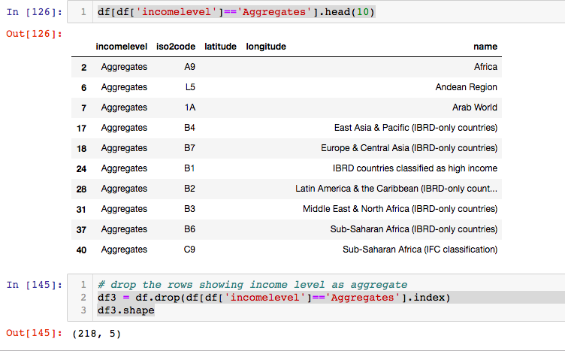

Slide 8
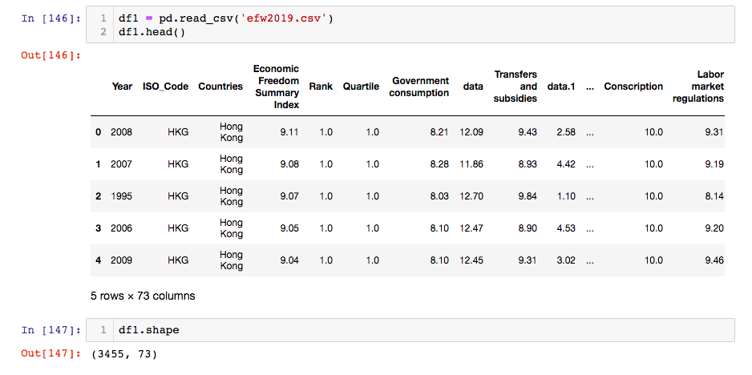

Slide 9
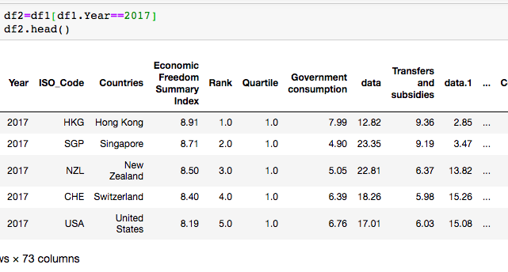

Slide 10
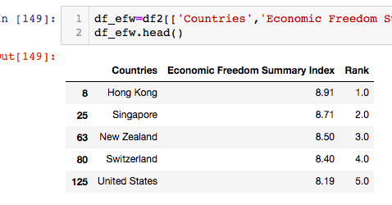

Slide 11
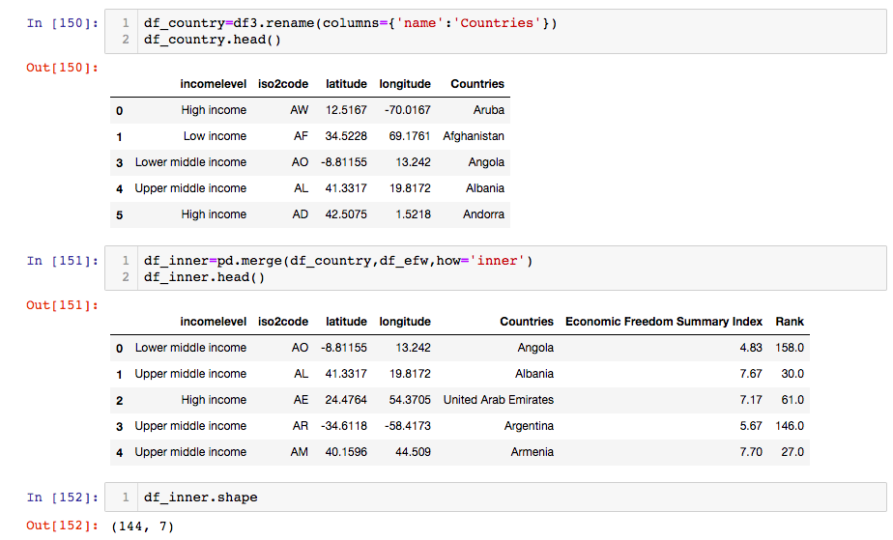

Slide 12
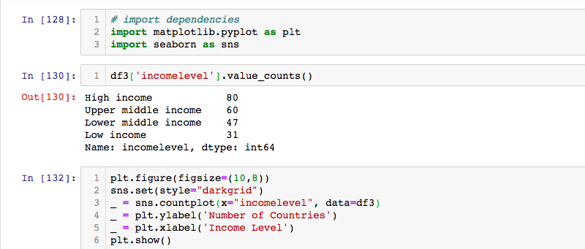

Slide 13
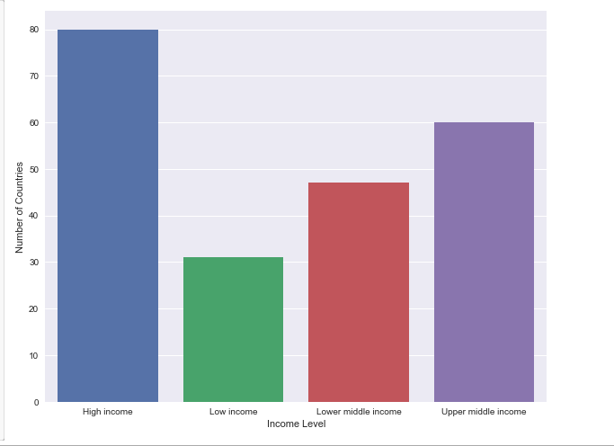

Slide 14
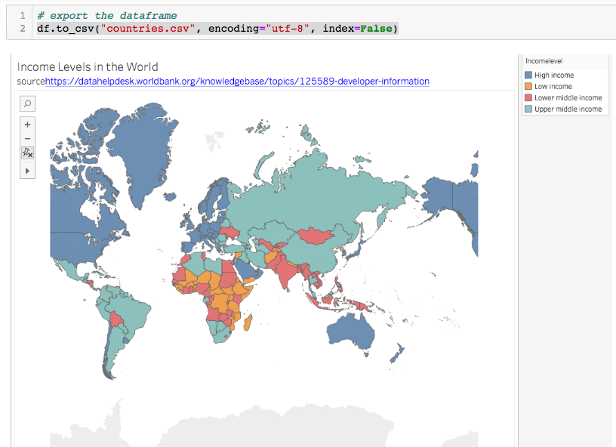

Slide 15
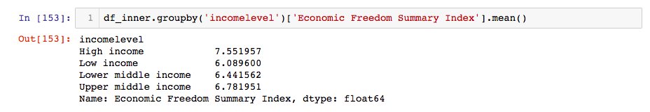

Slide 16
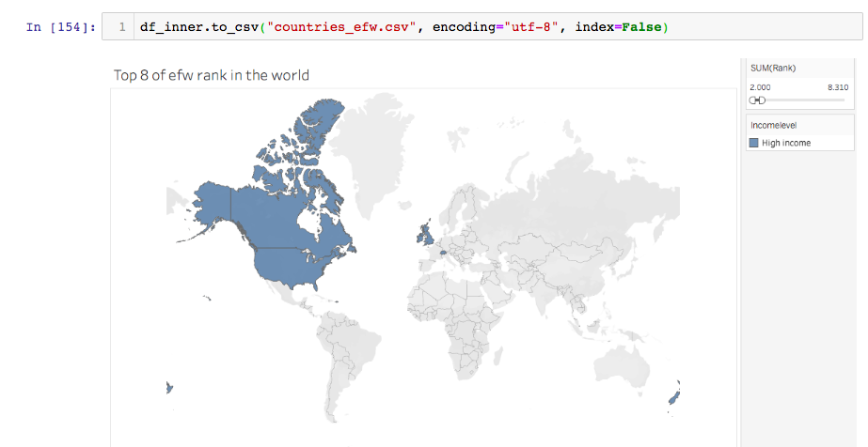

Slide 17
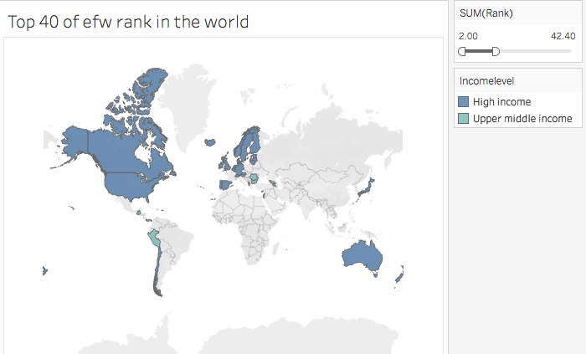

Slide 18
Conclusion
The income difference in the world is positively related to the economic freedom index.
The relationship with economic freedom is stronger when the countries are high and upper middle income.
This might offer some thoughts to economic polices.

